Slide 1
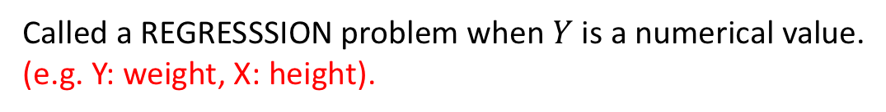
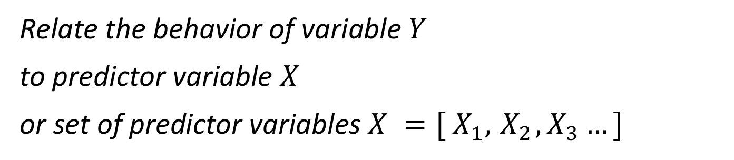
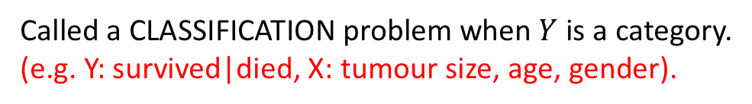
Statistical Learning
Statistical Learning: Building a statistical model of a dataset
so that we can:
(Machine Learning)
Relate the behavior of variable $Y$
to predictor variable $X$
or set of predictor variables $X ={[ X}_{1},{ X}_{2},X_{3}…]$
Called a REGRESSSION problem when $Y$ is a numerical value.
(e.g. Y: weight, X: height).
Called a CLASSIFICATION problem when $Y$ is a category.
(e.g. Y: survived|died, X: tumour size, age, gender).
ISSU0053 Data Science Dr Phil Lewis

Slide 2
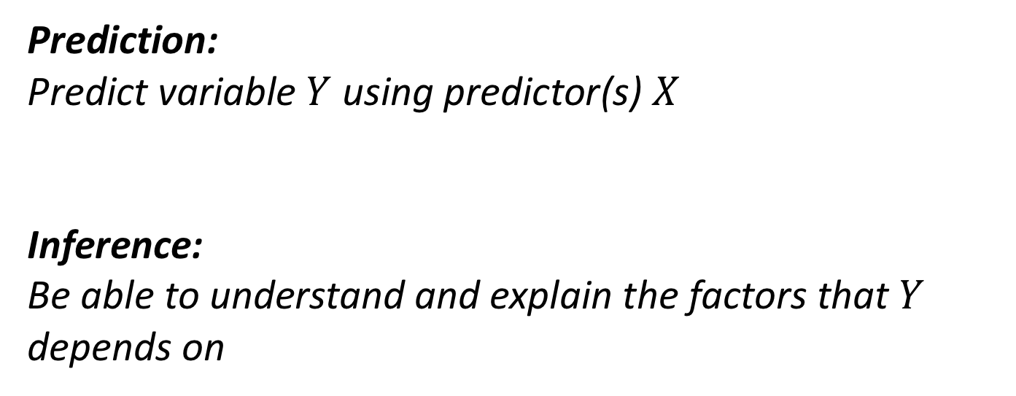
Statistical Learning
Statistical Learning: Building a statistical model of a dataset
so that we can:
(Machine Learning)
Prediction:
Predict variable $Y$ using predictor(s) $X$
Inference:
Be able to understand and explain the factors that $Y$ depends on
(e.g. predict weight using height, gender, age).
(e.g. be able to describe trend between weight and age).
ISSU0053 Data Science Dr Phil Lewis

Slide 3
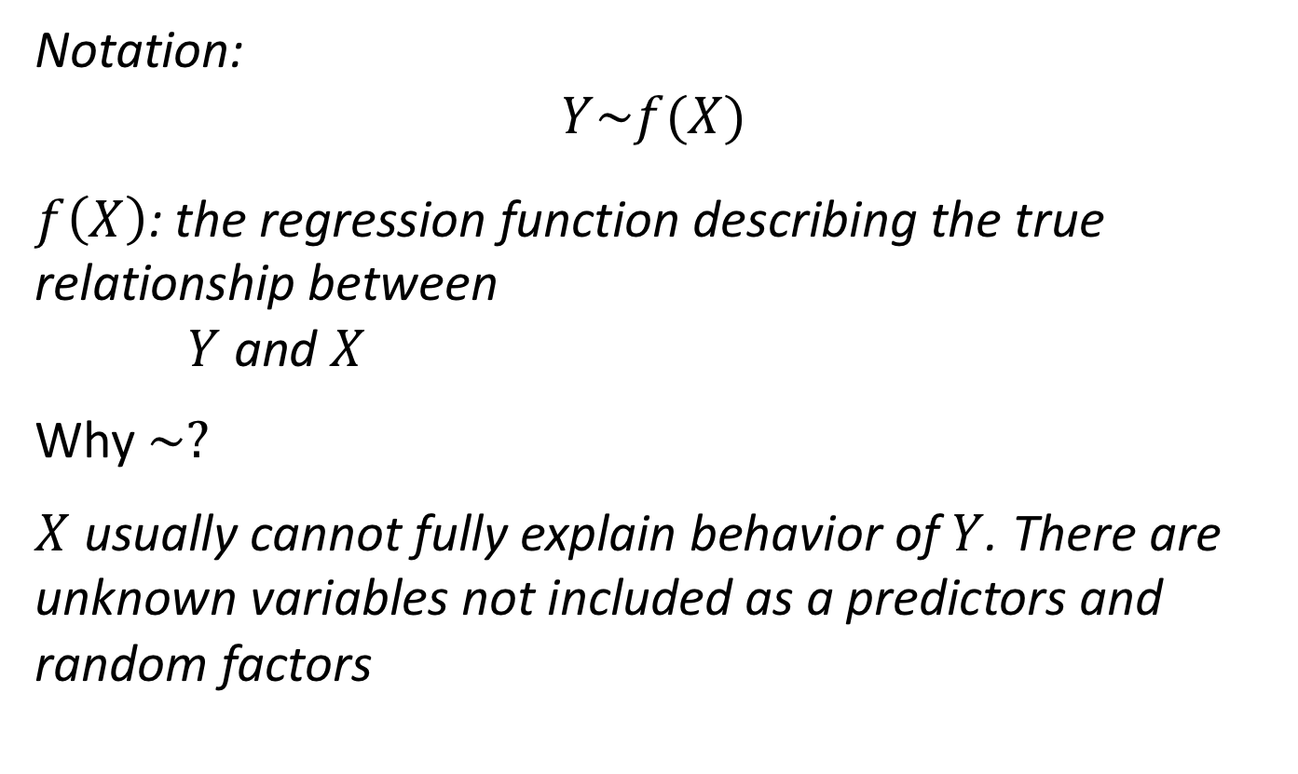
Statistical Learning
Relate the behavior of variable $Y$to predictor $X$ / predictors $X ={[ X}_{1},{ X}_{2},X_{3}…]$
Notation:
$$Y\sim f(X)$$
$f\left(X\right)$: the regression function describing the true relationship between
$Y$ and $X$
Why $\sim ?$
$X$ usually cannot fully explain behavior of $Y$. There are unknown variables not included as a predictors and random factors
ISSU0053 Data Science Dr Phil Lewis

Slide 4

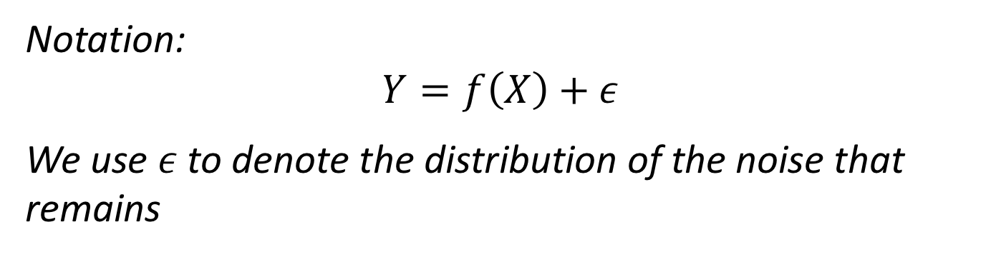




Statistical Learning
Relate the behavior of variable $Y$to predictor $X$ / predictors $X ={[ X}_{1},{ X}_{2},X_{3}…]$
Notation:
$$Y=f\left(X\right)+ε$$
We use $ε$to denote the distribution of the noise that remains
$$Y$$
$$Y−f(X)$$
$$ε$$
$$f\left(X\right)$$
$$X$$
ISSU0053 Data Science Dr Phil Lewis

Slide 5
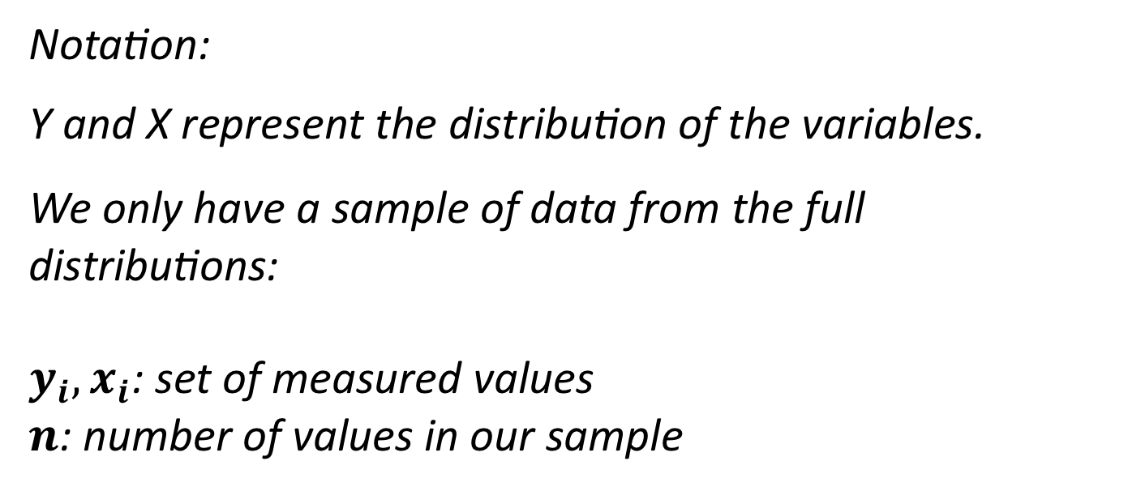
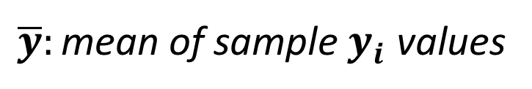
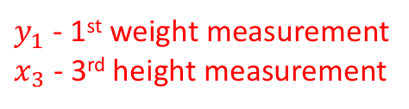
Statistical Learning
Relate the behavior of variable $Y$to predictor $X$ / predictors $X ={[ X}_{1},{ X}_{2},X_{3}…]$
Notation:
Y and X represent the distribution of the variables.
We only have a sample of data from the full distributions:
$y_{i}, x_{i}$: set of measured values
$n$: number of values in our sample
$y_{1}$ - 1st weight measurement
$x_{3}$ - 3rd height measurement
$\overline{y}:{\text{mean} \text{of} \text{sample} y}_{i}$ values
y bar
ISSU0053 Data Science Dr Phil Lewis

Slide 6
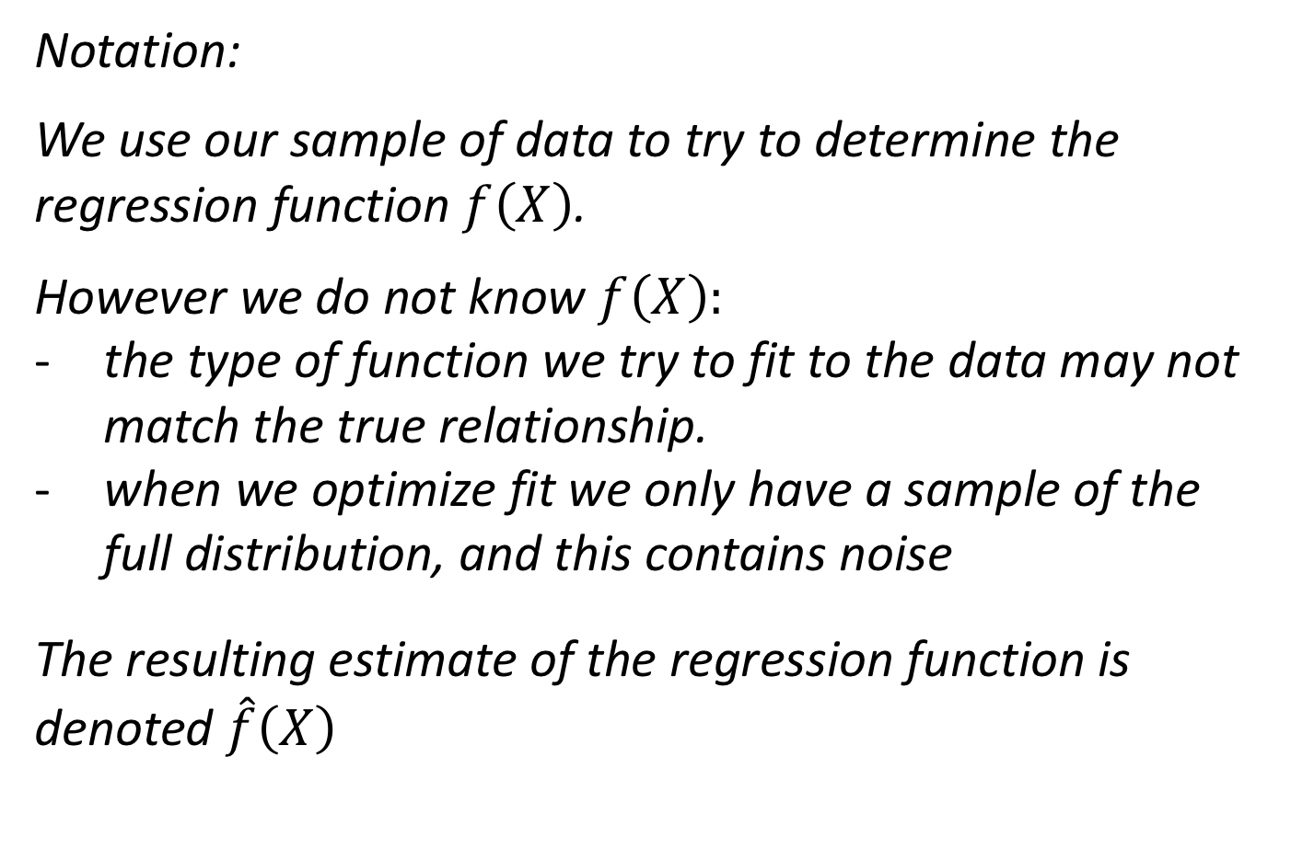
Statistical Learning
Relate the behavior of variable $Y$to predictor $X$ / predictors $X ={[ X}_{1},{ X}_{2},X_{3}…]$
Notation:
We use our sample of data to try to determine the regression function $f\left(X\right)$.
However we do not know $f\left(X\right):$
the type of function we try to fit to the data may not match the true relationship.
when we optimize fit we only have a sample of the full distribution, and this contains noise
The resulting estimate of the regression function is denoted $\hat{f}\left(X\right)$
f hat
ISSU0053 Data Science Dr Phil Lewis

Slide 7
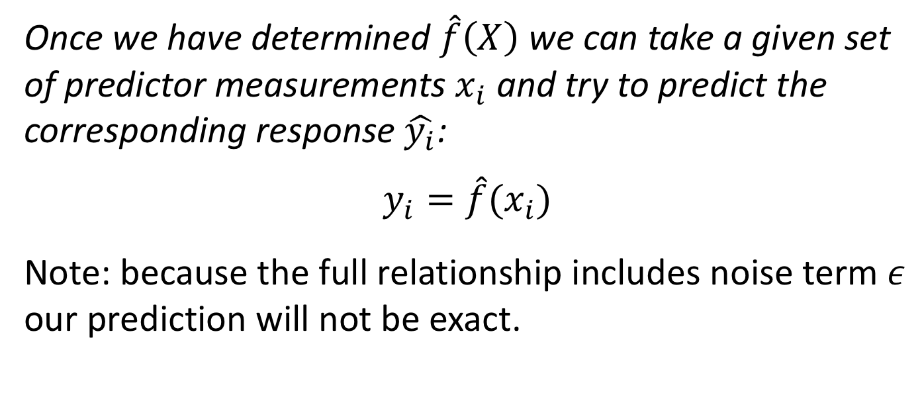
Statistical Learning
Relate the behavior of variable $Y$to predictor $X$ / predictors $X ={[ X}_{1},{ X}_{2},X_{3}…]$
Once we have determined $\hat{f}\left(X\right)$ we can take a given set of predictor measurements $x_{i}$ and try to predict the corresponding response $\hat{y_{i}}$:
$$y_{i}=\hat{f}{(x}_{i})$$
Note: because the full relationship includes noise term $ε$ our prediction will not be exact.
ISSU0053 Data Science Dr Phil Lewis

Slide 8

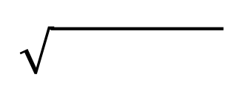


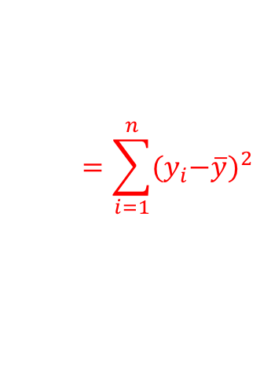
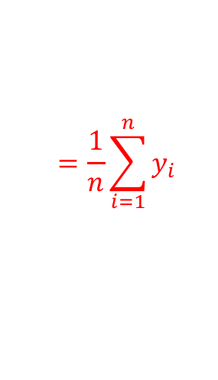
Measuring performance of our model
Relate the behavior of variable $Y$to predictor $X$ / predictors $X ={[ X}_{1},{ X}_{2},X_{3}…]$
mean = sum of data / n
TSS = sum of squared deviations from mean
standard error = TSS/(n-1)
$$=\frac{1}{n}\sum_{i=1}^{n}{y_{i}}$$
$$Y$$
$$\overline{y}$$
$$=\sum_{i=1}^{n}{{{(y}_{i}−\overline{y})}^{2}}$$
$$X$$
(estimated from sample of size n)
ISSU0053 Data Science Dr Phil Lewis

Slide 9
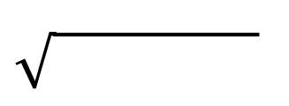

Measuring performance of our model
Relate the behavior of variable $Y$to predictor $X$ / predictors $X ={[ X}_{1},{ X}_{2},X_{3}…]$
RSS = sum of squared deviations from mean
or sum of squared errors.
$$Y$$
Measures of fit performance:
$$\hat{y_{i}}=B_{0}+B_{1}x_{i}$$
MSE = RSS / n
RMSE = MSE
$$X$$
fraction of variance explained by model
R² = 1 – RSS/TSS
ISSU0053 Data Science Dr Phil Lewis

Slide 10
Measuring performance of our model
Issue: RSS always decreases as we add predictors into our model.
When we add a predictor to a model, we optimize the associated coefficient to minimize RSS.
Even a random variable will have some chance (low) positive or negative correlation with a response – the fit algorithm uses this to reduce RSS for our training data.
RSS always decreases as we add more parameters in - even if there is no relationship between added predictor X and response Y.
THEREFORE…
RSS (and R² MSE and RMSE as defined on previous slide) from the fit results are no good for comparing models with different numbers of predictors.
ISSU0053 Data Science Dr Phil Lewis

Slide 11
Measuring performance of our model
Solutions:
i) Don’t measure fit RSS and R² using data used to train/fit the model. Use a test dataset containing new data points. (needs extra data!)
ISSU0053 Data Science Dr Phil Lewis

Slide 12
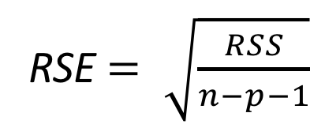
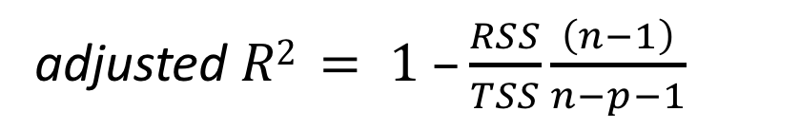
Measuring performance of our model
Solutions:
i) Don’t measure fit RSS and R² using data used to train/fit the model. Use a test dataset containing new data points. (needs extra data!)
ii) Use statistics that take account of the number of predictors used; these penalize models using large numbers of predictors. (relies on statistical assumptions)
adjusted $R2 = 1 –\frac{RSS}{TSS}\frac{\left(n−1\right)}{n−p−1}$
Residual Standard Error
RSE $= \sqrt{\frac{RSS}{n−p−1}}$
ISSU0053 Data Science Dr Phil Lewis

Slide 13
Measuring performance of our model
Solutions:
ii) Use statistics that take account of the number of predictors used; these penalize models using large numbers of predictors. (relies on statistical assumptions)
Alternatives to Adj. R² and RSE:
AIC
Akaike Information Criterion
BIC
Bayes Information Criterion
Lower AIC, BIC means better fit.
ISSU0053 Data Science Dr Phil Lewis

Slide 14
Measuring performance of our model
Solutions:
ii) Use statistics that take account of the number of predictors used; these penalize models using large numbers of predictors. (relies on statistical assumptions)
Alternatives to Adj. R² and RSE:
AIC
Akaike Information Criterion
BIC
Bayes Information Criterion
Lower AIC, BIC means better fit.
Note: the absolute value does not meaning, only differences between models.
(You may see R functions give different AIC,BIC values because they use different baselines)
You can use any of Adj Rsq, RSE, AIC, BIC to measure quality of fit between models with different numbers of predictors.
(use whichever is easier to access different R functions let you use different ones).
ISSU0053 Data Science Dr Phil Lewis

